Slide 1
Artificial Intelligence
Glena Aziz Qadir

Slide 2
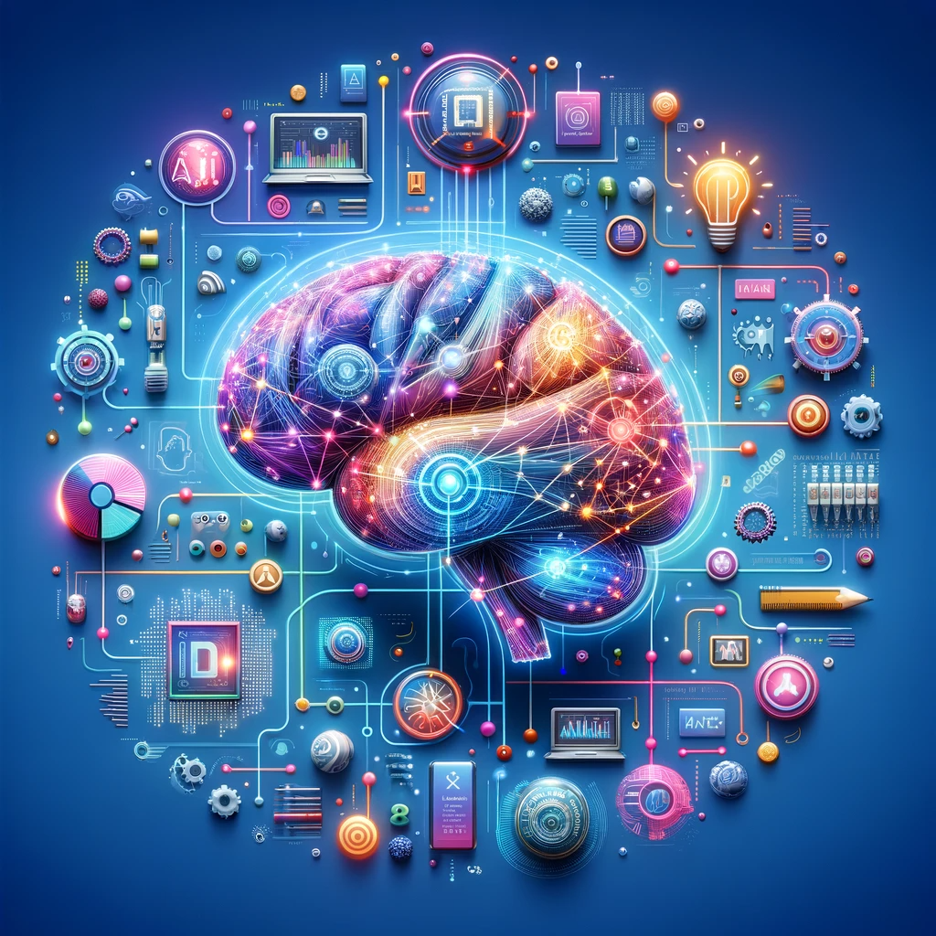
Introduction
AI: Artificial intelligence (AI) is technology that enables computers and machines to simulate human learning, comprehension, problem solving, decision making, creativity.
Applications and devices equipped with AI can see and identify objects. They can understand and respond to human language. They can learn from new information and experience. They can make detailed recommendations to users and experts. They can act independently, replacing the need for human intelligence or intervention (a classic example being a self-driving car).

Slide 3
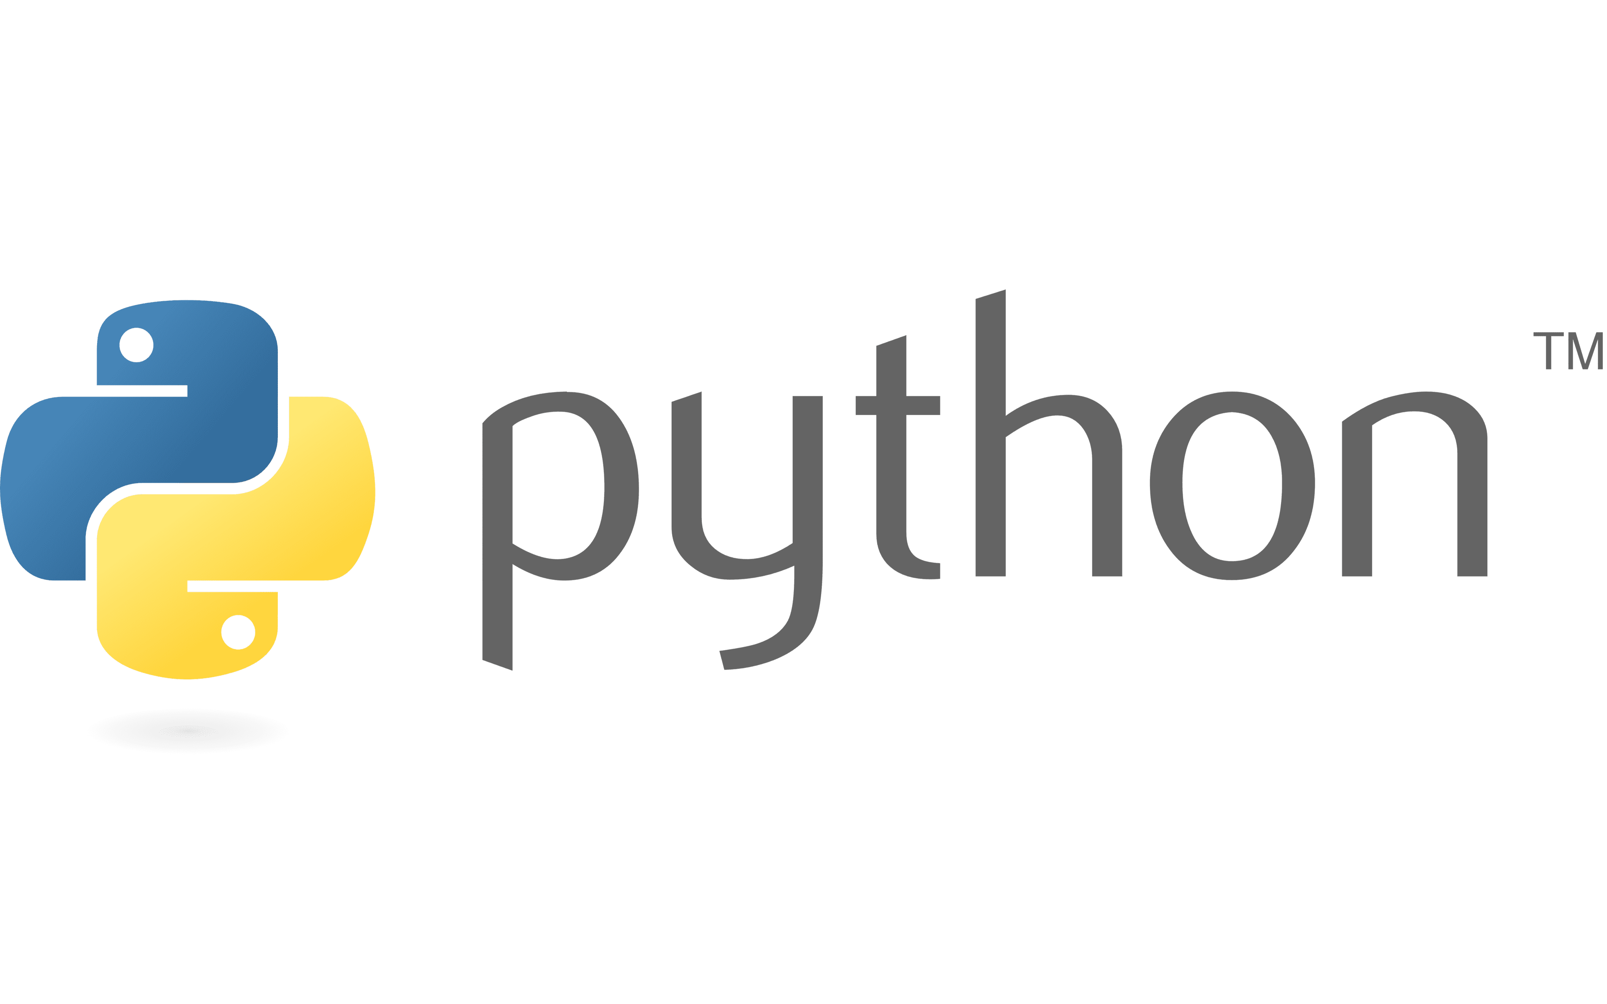
What is Python
python is an interpreted general- purpose or (multi-purpose) high level programming language with easy syntax and dynamic semantics.’
It was created by Guido van Rossum, and released in 1991.

Slide 4
Python Comments
Comment lines provide documentation about your program
Anything after the “#” symbol is a comment
Ignored by the computer
# I’m a programmer
# First python program
# This is my code

Slide 5
Python Variables
Variables are containers for storing data values.
x = 5
y = "John"
print(x)
print(y)
Variables do not need to be declared with any particular type, and can even change type after they have been set.
x = 4 # x is of type int
x = "Sally" # x is now of type str
print(x)

Slide 6
Count….
You can get the data type of a variable with the type() function.
x = 5 y = "john" print(type(x)) print(type(y))
String variables can be declared either by using single or double quotes:
x="john" # is the same as y='john'

Slide 7
Casting
Specify a variable type
Python is an object-orientated language, and as such it uses classes to define data types.
Casting in python is therefore done using constructor functions
Int() - constructs an integer number from an integer literal, a float literal (by removing all decimals), or a string literal (providing the string represents a whole number)
x = int(1) # x will be 1 y = int(2.8) # y will be 2
Float() - constructs a float number from an integer literal, a float literal or a string literal (providing the string represents a float or an integer)
y = float(2.8) # y will be 2.8
Str() - constructs a string from a wide variety of data types, including strings, integer literals and float literals
x = str("s1") # x will be 's1'

Slide 8
Variable Names
A variable can have a short name (like x and y) or a more descriptive name (age, FirstName, School_name).
A variable name must start with a letter or the underscore character
myvar = “student" , my_var = “student" _my_var = “student" myvar = “student" , myvar = “student" , myvar2 = “student"
A variable name can only contain alpha-numeric characters and underscores (a-z, 0-9, and _ )
Variable names are case-sensitive (age, Age and AGE are three different variables)
A variable name cannot be any of the python keywords.
A variable name cannot start with a number
2myvar = “student"

Slide 9
Count….
Assigning values to multiple variables
x, y, z = "one", "two", "three"
Assigning the same value to multiple variables
x = y = z = "one“

Slide 10
Data Types
1- Numbers
Int: Int, or Integer, is a whole number, positive or negative.
x = 1 , y=-1
Float: Float, or "floating point number" is a number, positive or negative, containing one or more decimals.
X=
Complex: Complex numbers are written with a "j" as the imaginary part
x = 3+5j y = 5+5j z = x+y print(type(X)) print(type(Y)) print(Z)

Slide 11
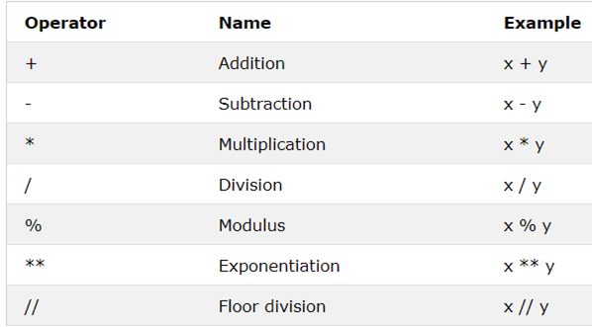

Slide 12
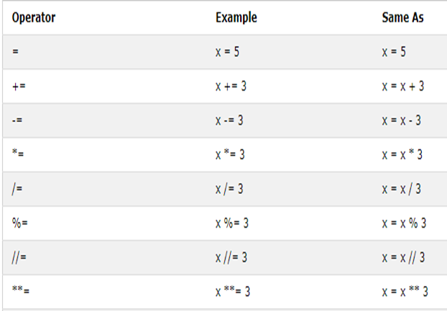

Slide 13
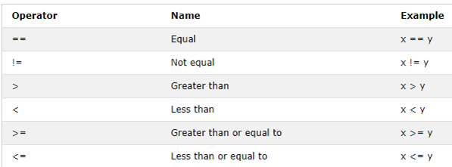

Slide 14
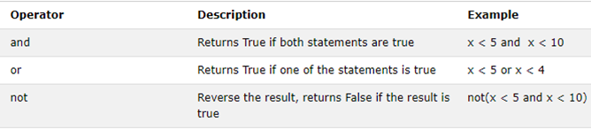

Slide 15
Data Types
2- String
Strings in python are surrounded by either single quotation marks, or double quotation marks. ‘Hello world’ = " Hello world“
Ex: a = " Hello world " print(a)
To get the length of a string, use the len() function.
print(len(A))
get the character at position (x)
print(A[1])
print(A[-2])
print(A[2:6])

Slide 16
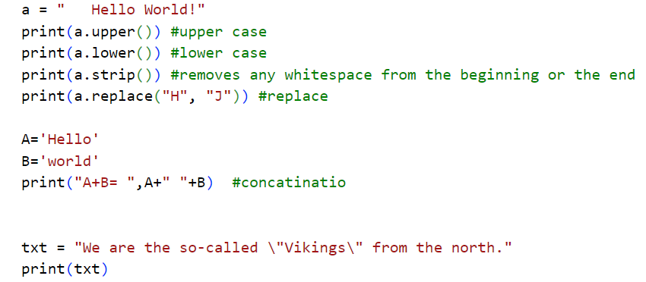
Ex:

Slide 17
Code | Result
\' | Single Quote
\\ | Backslash
\n | New Line
\r | Carriage Return
\t | Tab
\b | Backspace

